Slide 1
Lindsey Clark
lindseyclark@hey.com
www.linkedin.com/in/lindseymclark29/
github.com/lindseymclark
world.hey.com/lindseyclark/
live in Knoxville, one pug Bo, road and mountain bike, like to eat, hike, play golf, love the Webb telescope

Slide 2




Slide 3
“According to the Harvard Business Review, the biggest obstacles to creating data-based businesses aren’t technical; they’re cultural, a kind of mindset.”
https://www.linkedin.com/pulse/data-science-mindset-6-principles-build-healthy-total-data-science/

Slide 4
Kick-off Case Study
You are tasked with predicting the risk of development of type 2 diabetes in a patient population using both demographic data and EMR data. Your options:
2. You can develop a logistic regression model in 6 weeks with a classification accuracy (true positives + true negatives/total) of 0.77.
3. You can develop a 60-layer neural net, deployed, with model monitoring and logging and Bayesian hyperparameter tuning in 24 weeks with a classification accuracy (true positives + true negatives/total) of 0.85.
As the leader of data science, which option would you recommend to the c-suite and why?
1. You can use BMI threshold to identify patients at risk for diabetes in 1 week.

Slide 5

Innovation vs. Immediacy
Vin Vashishta

Slide 6
The story of the non-pragmatic data scientist….
Long lead time to implement a business solution
Solution is too complex/inexplicable
Solution ignores precedence
Solution needs significant amount of production capabilities to scale/deploy
Notes:
Talk about initial work feedback, and how I’m reconsidering the recommendation of no model in lieu of complex solutions

Slide 7
At the time, I had a team of 6 data scientists, which cost ~$850k/year. If I was in charge of that budget, how would I use the money? Would I invest in the project?

Slide 8
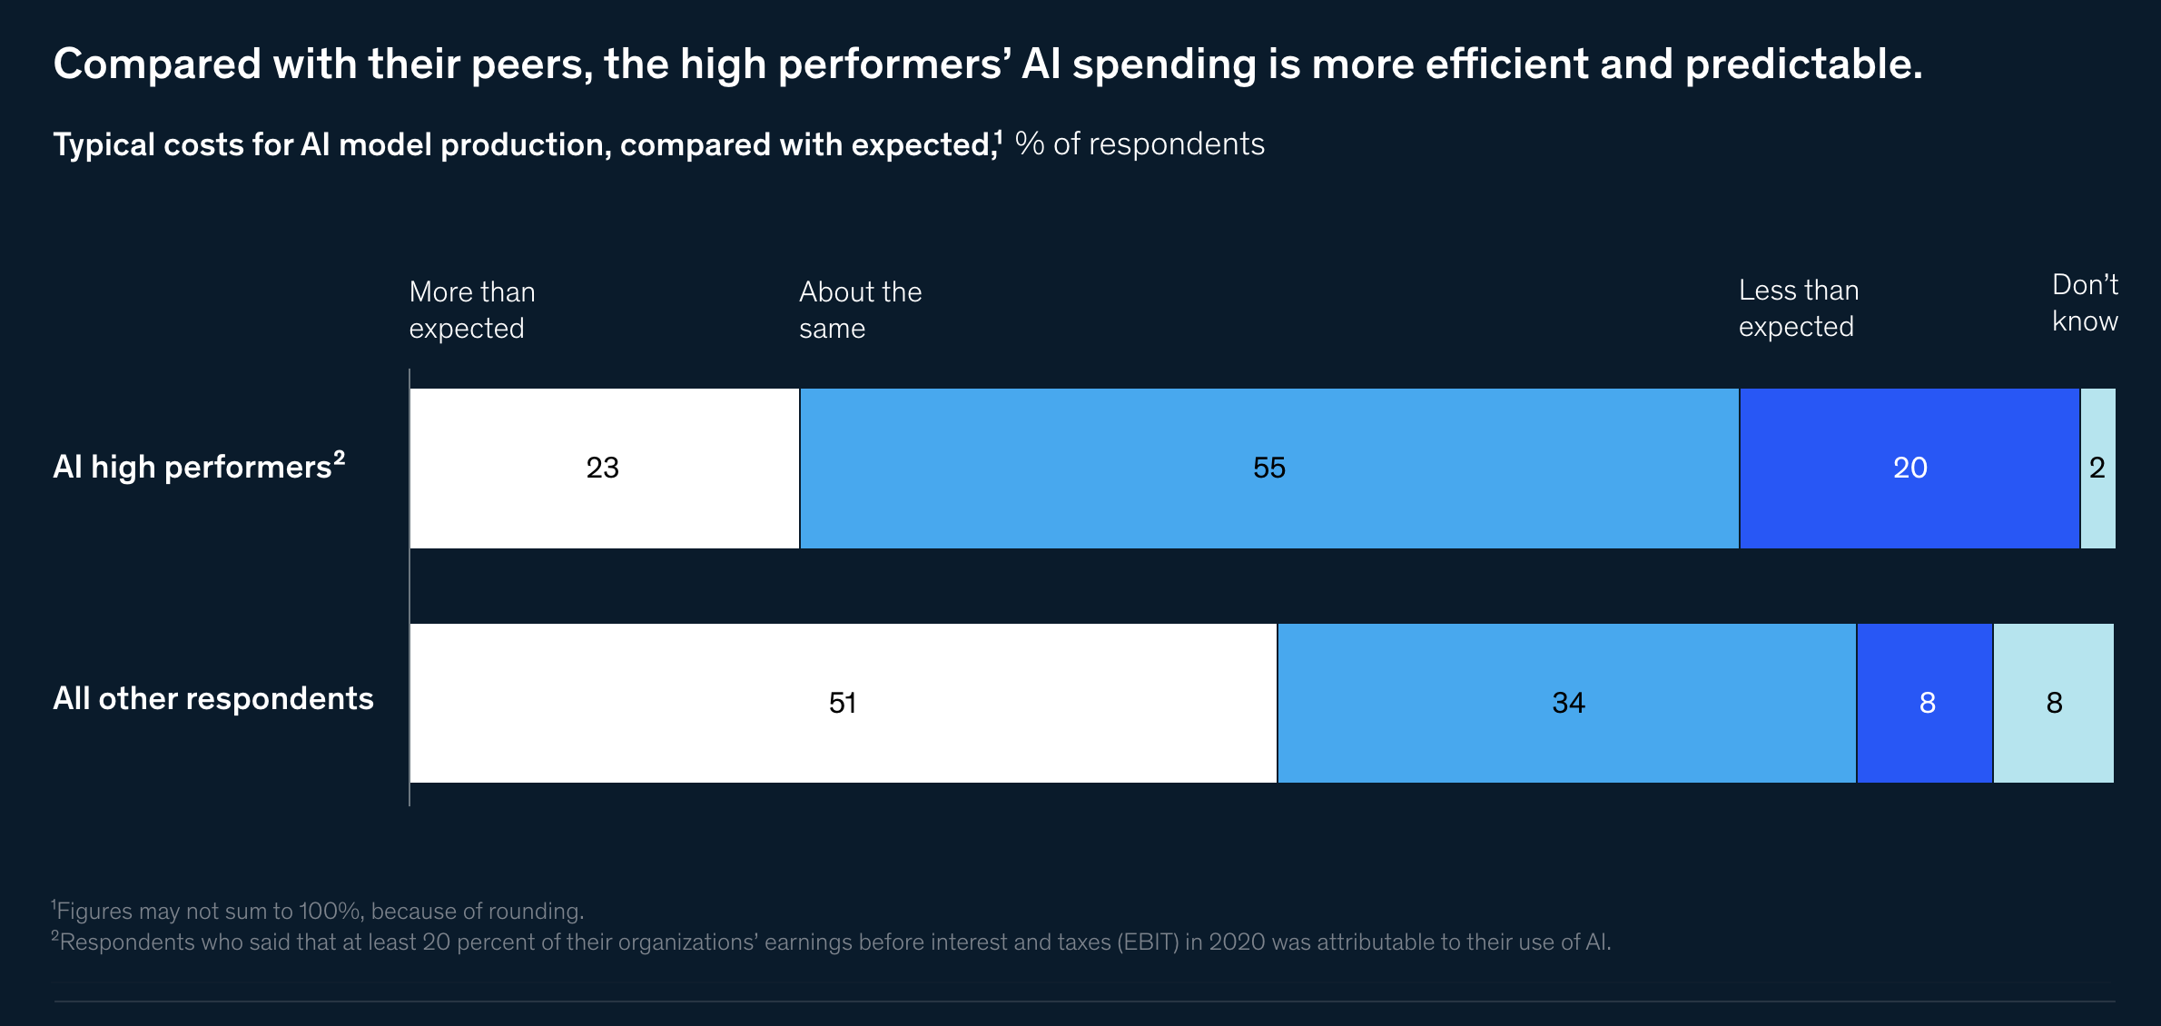

22-27% of respondents report >=5% of EBIT attributable to AI initiatives
56% of companies report AI adoption in at least one area, up from 50% in 2020
https://www.mckinsey.com/business-functions/quantumblack/our-insights/global-survey-the-state-of-ai-in-2021

Slide 9
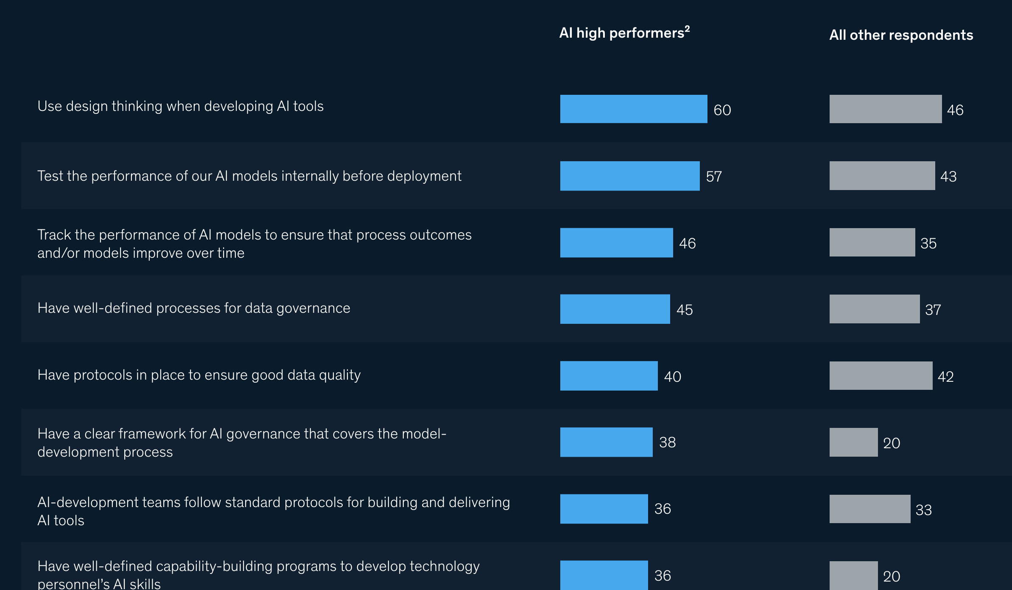

Slide 10
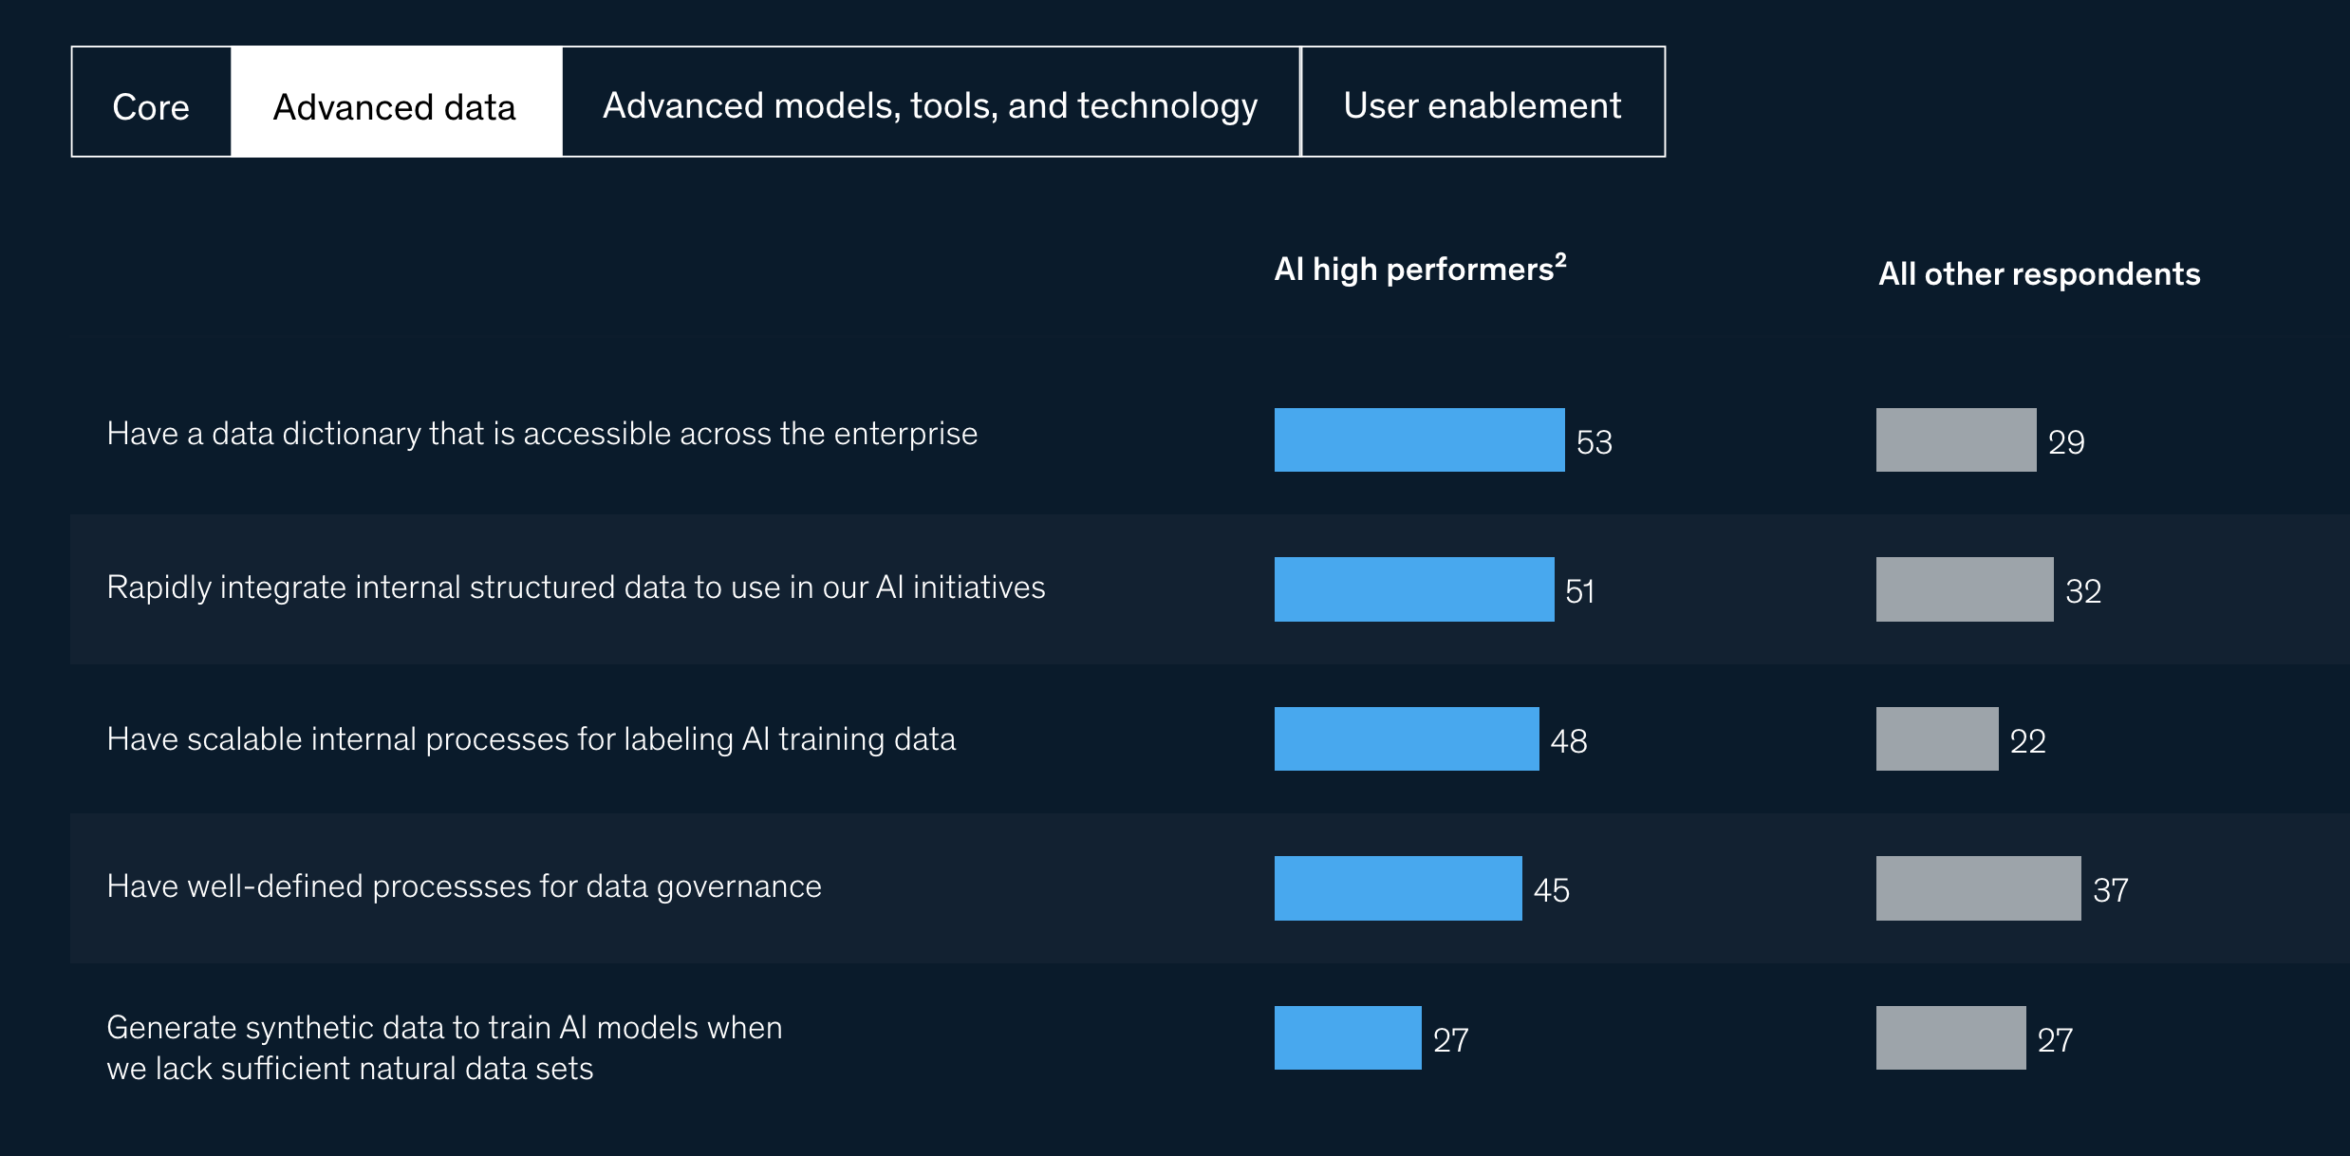

Slide 11
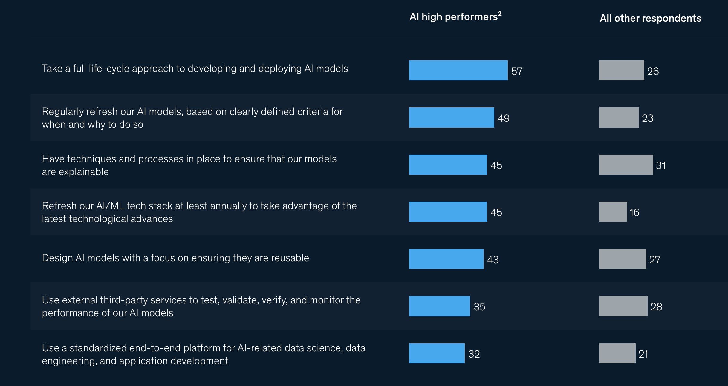

Slide 12

What is a Data Science Mindset?
Thinking 3-5 years ahead
Using data for ideas and direction
Comfortable with failure and risk
Willing and able to invest in infrastructure and personnel necessary to enable data science/AI
Ability to place your data scientists close to the business
Willingness to challenge traditional norms
Notes:
No single employee who can handle all the data preparation, modeling, QA, and deployment activities

Slide 13
The Basics

Slide 14
The Algebra of Data Science Success
The right people and the right leadership
The right time
The right data and infrastructure
The right (and defined) business problem
https://www.linkedin.com/pulse/data-science-vs-c-suite-solution-david-boyle/

Slide 15
Is it ever strategic to over-engineer a data solution?

Slide 16
For consideration…
Changing the algorithm is difficult for clients—change fatigue
Do you have a blue or red ocean strategy?

Slide 17

Change management to a data-focused organization
Listen and ask many questions
Implement quick wins
View yourself as a partner to other functional areas
Get as close to customers as possible
Be candid about what you need to be sucessful
Identify 1-3 things that are of high importance to your partners, and talk about your solution in those terms
Gain trust and champion(s) in the executive levels

Slide 18
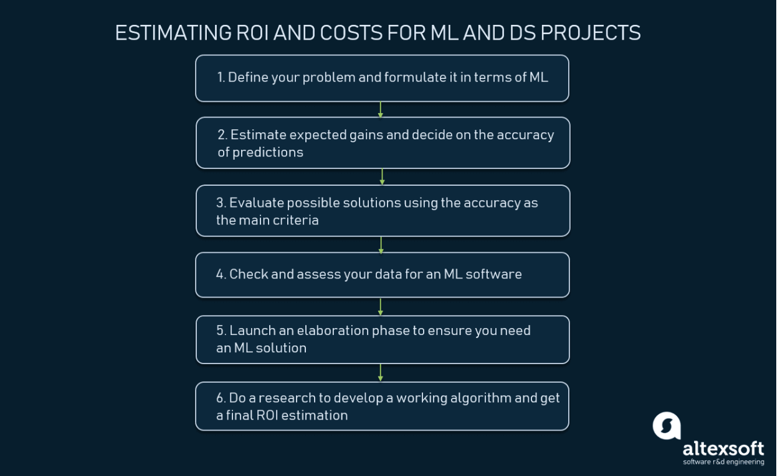
How to measure data science/AI impact and ROI
https://www.altexsoft.com/blog/business/how-to-estimate-roi-and-costs-for-machine-learning-and-data-science-projects/
Notes:
Is there a marketing benefit? What about white paper?

Slide 19
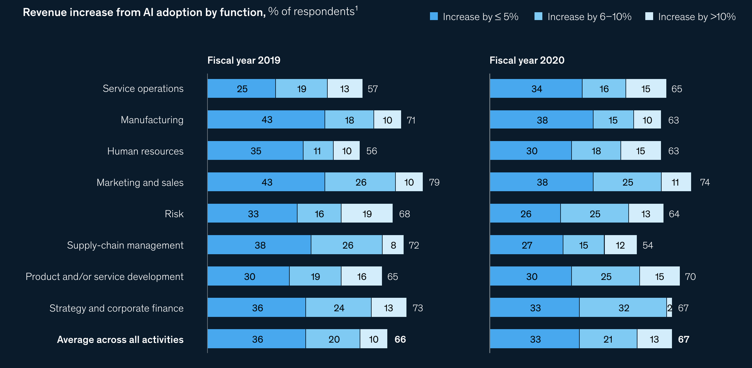
Notes:
22-27% of respondents report >=5% of EBIT attributable to AI initiatives
56% of companies report AI adoption in at least one area, up from 50% in 2020

Slide 20
Case Study: Customer-centric business problem
The business wants to improve targeted marketing by personalizing a market strategy to customer segments.
Option 1: Divide customers into segments based on simple demographic and/or sales information and personalize market strategy to each segment.
Option 2: Build an unsupervised classifier with adjusted rand index of at least 0.8 and personalize market strategy to each segment.
Notes:
https://www.cio.com/article/190888/5-famous-analytics-and-ai-disasters.html

Slide 21

Data Science Mindset Case Study
Ask yourself….
What is the problem to be solved?
What are the current solutions? Is there no solutions, or you are improving on existing solutions?
Is time to market a factor?
What is the risk to people or the business if your prediction/classification is incorrect?

Slide 22
Case Study 1: Customer-centric business problem. What would a data science mindset do?
Business-logic solution: Option 1 | Data Science Solution: Option 2
Simple and quick Easy to implement Easy to explain Sensitive, but not specific Hard to change later as the market shifts Has been done before | Longer lead time for development More challenging to explain Potentially greater deployment needs Specific, but not sensitive Hard to change later as the market shifts Has never been seen in the market

Slide 23
Bonus Case Study
You are tasked with predicting the risk of development of type 2 diabetes in a patient population using both demographic data and EMR data. Your options:
You can develop a logistic regression model in 6 weeks with a classification accuracy (true positives + true negatives/total) of 0.77.
You can develop a 60-layer neural net, deployed, with model monitoring and logging and Bayesian hyperparameter tuning in 24 weeks with a classification accuracy (true positives + true negatives/total) of 0.85.
As the leader of data science, which option would you recommend to the c-suite?

Slide 24
Final Thoughts
What are the benefits of a data science solution vs. a business logic solution? Use the data science mindset to guide you.
Sensitivity/Specificity tradeoff
What is the risk of being wrong?
Can we easily change the method at a later time?
Cost, time to market, explainability factors

Slide 25
What I’m Reading Now
Valuation, McKinsey and Co, https://www.mckinsey.com/business-functions/strategy-and-corporate-finance/our-insights/valuation-measuring-and-managing-the-value-of-companies
How to write a business use case, https://www.wrike.com/blog/what-is-a-use-case/
Prediction Machines: The Simple Economics of Artificial Intelligence, https://www.goodreads.com/book/show/36484703-prediction-machines
Vin Vashishta High ROI Data Science Substack, https://www.linkedin.com/in/vineetvashishta/
Chad Sanderson Data Products Substack, https://dataproducts.substack.com/
Scott Galloway, Pivot and ProfG Podcasts, https://podcasts.apple.com/us/podcast/pivot/id1073226719
Python Black, PEP8 formatter, https://black.readthedocs.io/en/stable/
Dagster Orchestration Platform, https://dagster.io/

